Slide 1
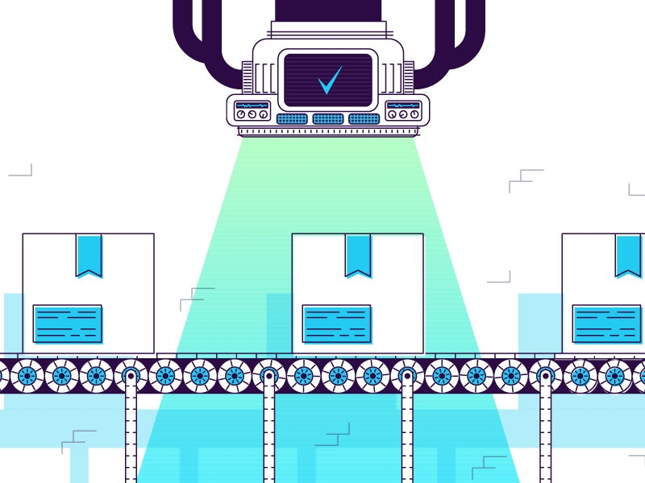
Dataset Formation, Detection, Classification, and Augmentation of Packet Boxes for Enhanced Warehouse Operations
Packet
Packet
Name: Gopi Ravi Teja Gudupu
Matriculation: 1710623
Branch: M.Sc. Mechatronics
Guide: M.Sc. Micheal Aniebiet Ezekiel
Source: https://dribbble.com/shots/4371104-Check

Slide 2
Overview
Introduction & Objective
Detection Algorithms
Workflow
Dataset Exploration & Training Insights
Observations from Integration Meeting
Challenges & Key Insights

Slide 3
Introduction & Objective
1

Slide 4
Introduction
Warehouse Operational Inefficiencies
Limitations of Current Detection Methods
Role of Computer Vision in Automation
Project Aim and Scope
Improving Warehouse Efficiency through Automation
Source: https://siawms.com/
1. Introduction & Objective

Slide 5
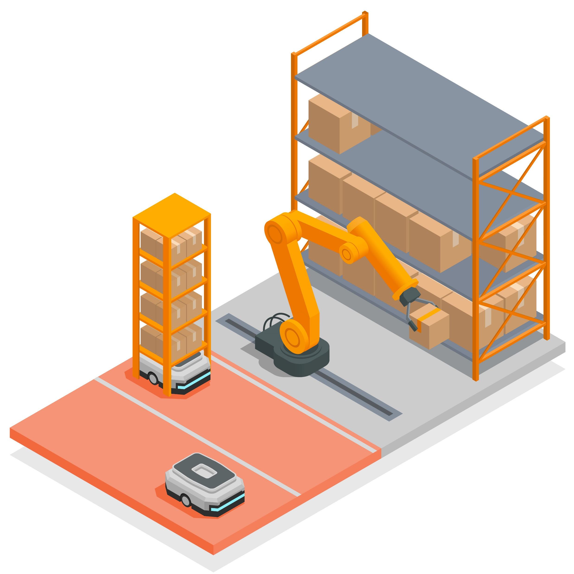
Objective
Primary Objective: Streamlining Packet Box Detection
Dataset Formation for Packet Box Images
Algorithm Training and Model Robustness
Application of Data Augmentation Techniques
Real-world Evaluation of System Accuracy
Expected Impact on Warehouse Operations
Source: https://www.freepik.com/vectors/warehouse-automation
1. Introduction & Objective

Slide 6
Detection Algorithms
2

Slide 7
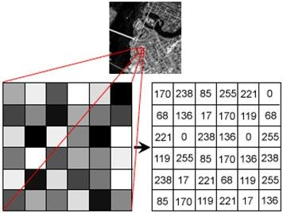
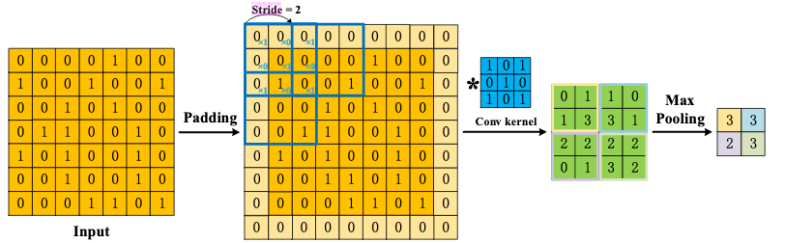
Understanding an Image
Image Processing
Pixels
Source: https://www.researchgate.net/figure/Matrix-for-certain-area-of-a-grayscale-image-17_fig3_325569674
Kernel
Stride
Padding
Source: https://samueljchu.com/showcase/A.I./Computer_Vision/
2. Detection Algorithms

Slide 8
Understanding Channels and Layers
Aspect | Layers | Channels
Definition | Individual stages through which the input data passes and transforming it. | Number of feature maps (filters) in a specific layer.
Role | Perform transformations on data, and learning higher-level features. | Capture different features (edges, textures, colors) from the input data.
Types | - Convolutional layers - Pooling layers - Fully connected layers - Activation layers | Channels are typically applied to convolutional layers, representing the depth of the feature maps.
Effect of Increasing | More layers lead to a deeper network, allowing for learning more complex patterns. | More channels lead to a wider network, allowing each layer to capture more detailed features.
Example | A CNN might have 10 layers, where the data is progressively transformed to higher-level features. | A convolutional layer might have 64 channels (filters), each producing a different feature map for the same input.
2. Detection Algorithms

Slide 9
Overview: Two Stage Networks Vs Single Shot Detection
Two Stage Networks
Single Shot Detection
Two-stage networks use a two-step approach for object detection.
Stage 1: Region Proposal Network (RPN) generates potential bounding boxes (regions of interest).
Stage 2: Classifies and refines proposed boxes to produce final detection.
Ex: R-CNN(Regions with Convolutional Neural Networks), Fast R-CNN
Single-shot detectors perform detection that achieve both object classification and localization in a single pass through the network.
Ex: YOLO(You Only Look Once), RetinaNet
2. Detection Algorithms

Slide 10
Comparison: Two-Stage Networks vs. Single-Shot Detection
Parameter | Two Stage Networks | Single Shot Detection
Speed | Slower due to sequential processing | Optimized for speed
Efficiency | May struggle with real-time applications | Suitable for applications requiring quick detections
Accuracy | Higher accuracy | Lesser accuracy
Implementation Complexity | Complex due to separate components | Easier due to simpler architecture
Resource Requirement | Require more computational resources | More efficient in terms of resource usage
Application | Ideal for applications where accuracy is prioritized over speed | Preferred for real-time applications where quick decisions are critical
2. Detection Algorithms

Slide 11
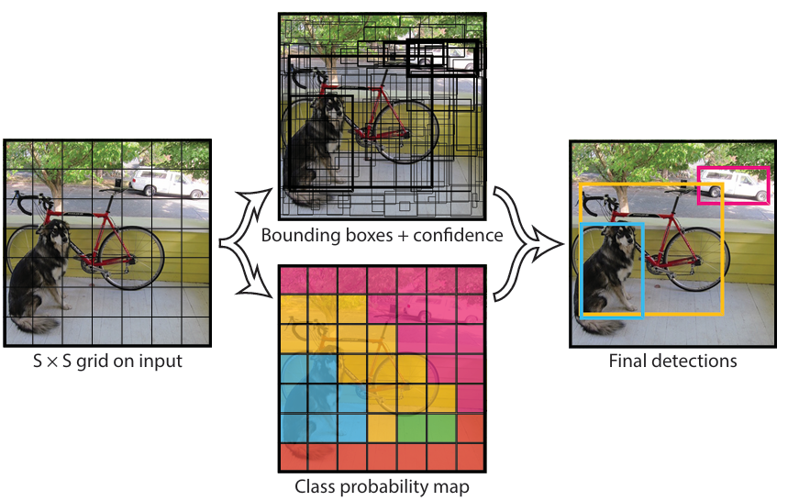
YOLO Algorithm
It divides the image into an SxS grid
For each grid cell, it predicts
B bounding boxes
Confidence for those boxes, and
C class probabilities
These predictions are encoded as an SxSx((B*5)+C)tensor.
Source: https://arxiv.org/pdf/1506.02640
2. Detection Algorithms

Slide 12
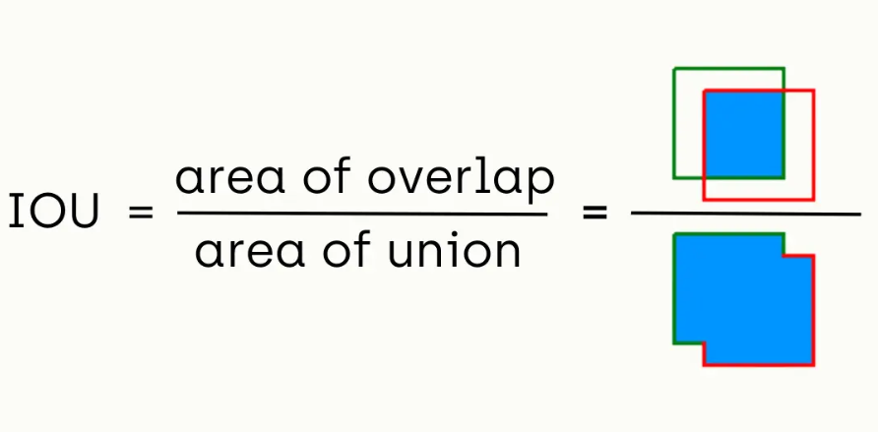
YOLO Algorithm
It measures the overlap between the predicted bounding box (P) and the ground truth bounding box (G)
The IoU score ranges from 0 to 1, where 0 indicates no overlap and 1 indicates a perfect match.
A higher IoU score indicates a more accurate object detection
Intersection over Union (IoU) is a common metric used to evaluate the performance of an object detection algorithm
2. Detection Algorithms

Slide 13
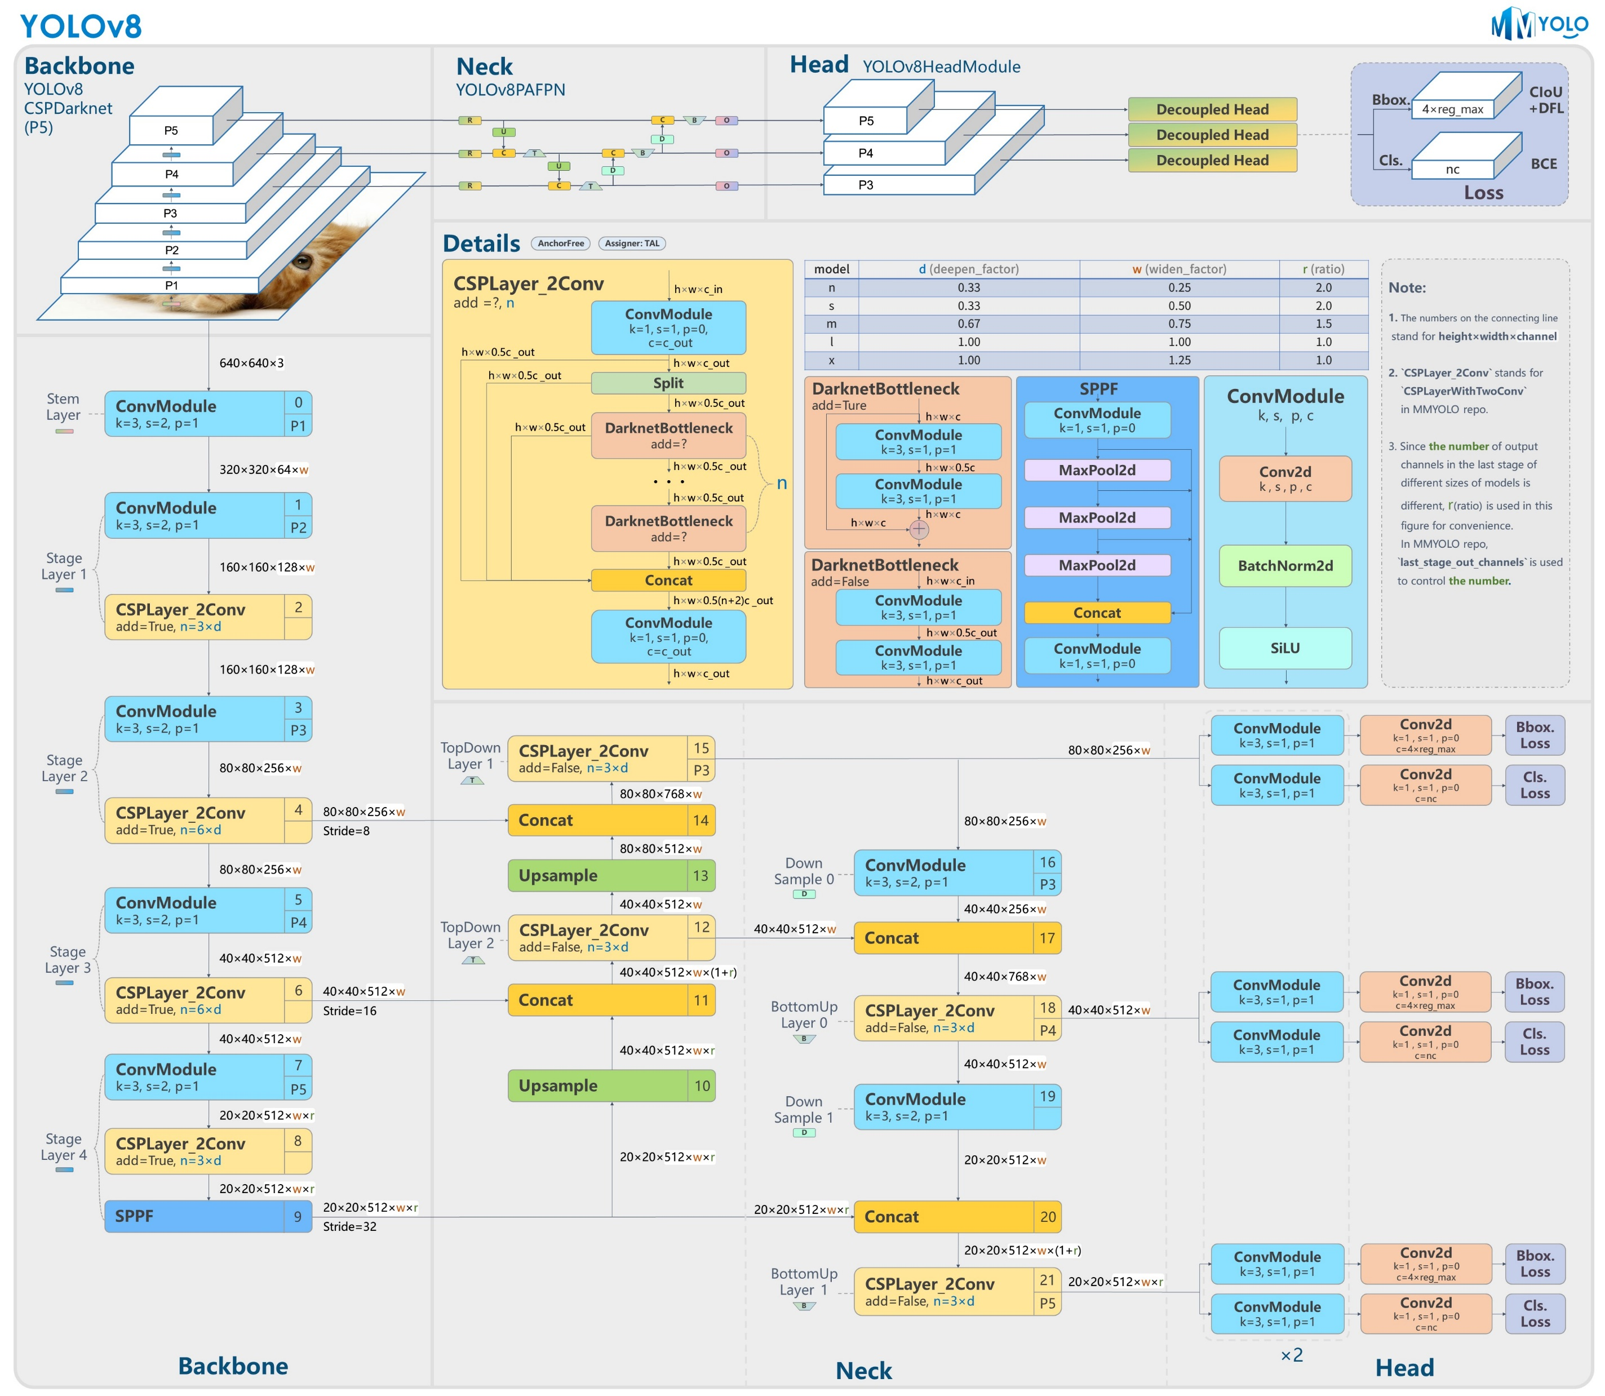
YOLO V8 Architecture
Main Components of Architecture
Backbone: Processes the picture and extracts important features like edges, colors, and shapes.
Neck: Focus on different parts of the picture.
Head: Look for objects in those parts.
Source: https://github.com/open-mmlab/mmyolo/tree/main/configs/yolov8
2. Detection Algorithms

Slide 14
YOLO V8 Architecture
Source: https://github.com/open-mmlab/mmyolo/tree/main/configs/yolov8
Models | Characteristics | Purpose
Nano | Smaller, Faster, Low Accuracy | Limited computational resources
Small | Good Accuracy and Speed | Balanced speed and accuracy
Medium | Improved accuracy and Computational cost | When precision is critical
Large | Higher accuracy but significant resources | Applications requiring maximum precision
XLarge | Exceptional Accuracy | Research and development
2. Detection Algorithms

Slide 15
YOLO V8 Architecture
Deepen Factor, Widen Factor, and Ratio
Hyperparameters to customize the architecture of YOLOv8 models.
Allows to adjust the depth and width of the network.
Source: https://github.com/open-mmlab/mmyolo/tree/main/configs/yolov8
Deepen Factor
Adding more layers to the backbone and neck of the model.
Deeper networks can capture more features but need more computational resources
Widen Factor
Increasing the number of channels in the convolutional layers of the backbone and neck.
Allows to adjust the depth and width of the network.
Ratio
Determines the balance between depth and width.
A ratio of 1 means that the depth and width are increased proportionally.
A ratio greater than 1 means that the depth is increased more than the width, and vice versa.
2. Detection Algorithms

Slide 16
YOLO V8 Architecture
Backbone
CSP (Cross-Stage Partial): Technique to improve the efficiency of a network by reducing the amount of computation required by splitting the feature maps into two parts, processing them separately, and then concatenating them back together.
Darknet: This is a family of neural networks originally designed for object detection.
The P1, P2, P3, P4, and P5 are feature maps which are extracted at different stages of the backbone.
Source: https://github.com/open-mmlab/mmyolo/tree/main/configs/yolov8
2. Detection Algorithms

Slide 17
YOLO V8 Architecture
Backbone
Stem Layer: Initial layer which extract basic features from the input image.
Stage Layers: Each stage layer is a block of layers that processes the feature maps from the previous stage. The stages become progressively more complex, extracting higher-level features.
CSPLayer_2Conv: This layer is a combination of two convolutional layers and a concatenation operation.
ConvModule: This layer is a basic building block of the network, consisting of a convolutional layer, a batch normalization layer, and an activation function.
SPPF: This layer is a spatial pyramid pooling layer that helps the network capture features at different scales.
Source: https://github.com/open-mmlab/mmyolo/tree/main/configs/yolov8
2. Detection Algorithms

Slide 18
YOLO V8 Architecture
Neck
Feature Pyramid Network (FPN): To take and combine features from different layers of the backbone and upscale them to common resolution to create multi-scale feature. Input: Feature maps from multiple stages of the backbone. Output: Multi-scale feature maps that have been used to retain information.
Path Aggregation Network (PAN): Refines the multi-scale features generated by the FPN. It involves convolutional layers and upsampling/downsampling to ensure feature alignment. Input: FPN feature maps. Output: Refined feature maps that incorporate information from both shallow and deep layers, improving object detection.
Source: https://github.com/open-mmlab/mmyolo/tree/main/configs/yolov8
2. Detection Algorithms

Slide 19
YOLO V8 Architecture
Neck
TopDown Layer 2: This layer upsamples the feature maps received from the deeper layers(Stage 4) of the backbone and combine/concatenate them to layer(Stage 3). By merging high-level features with finer details from shallower layers, this layer helps retain important spatial information that is critical for detecting smaller objects.
TopDown Layer 1: Similar to TopDown Layer 2, but layer upsamples features from another deeper layer (Stage 3) and combine/concatenate them to layer(Stage 2). Enhance the multi-scale feature representation further, allowing the model to effectively detect small, medium, and large objects
Source: https://github.com/open-mmlab/mmyolo/tree/main/configs/yolov8
2. Detection Algorithms

Slide 20
YOLO V8 Architecture
Neck
Down Sample 0: Reduces spatial dimensions of early-stage features.
Bottom Up Layer 0: Processes and refines low-level features.
Down Sample 1: Performs further downsampling of deeper feature maps.
Bottom Up Layer 1: Processes features from deeper stages.
Source: https://github.com/open-mmlab/mmyolo/tree/main/configs/yolov8
2. Detection Algorithms

Slide 21
YOLO V8 Architecture
Head
80x80x256w: High resolution, captures fine details, smaller receptive field. Objects detected are Small objects (e.g., cups, phones)
40x40x512w: Medium resolution, balances detail and context. Objects detected are Medium-sized objects (e.g., cars, bikes)
20x20x512w: Low resolution, captures global information, larger receptive field. Objects detected are Large objects (e.g., people, buildings)
Source: https://github.com/open-mmlab/mmyolo/tree/main/configs/yolov8
2. Detection Algorithms

Slide 22
Workflow
3

Slide 23
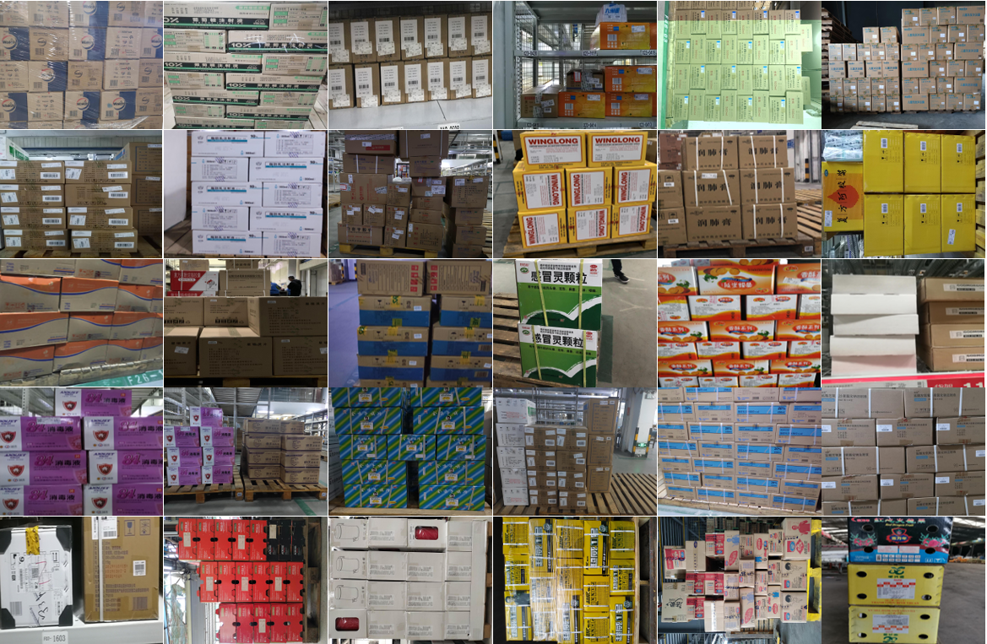
Workflow
Step 1: Collect required images
We have considered various images from multiple sources.
We used an online dataset named SDC(Stacked Carton Dataset), a large-scale carton dataset for the research community from GitHub.
Source: https://arxiv.org/pdf/2102.12808
3. Workflow

Slide 24
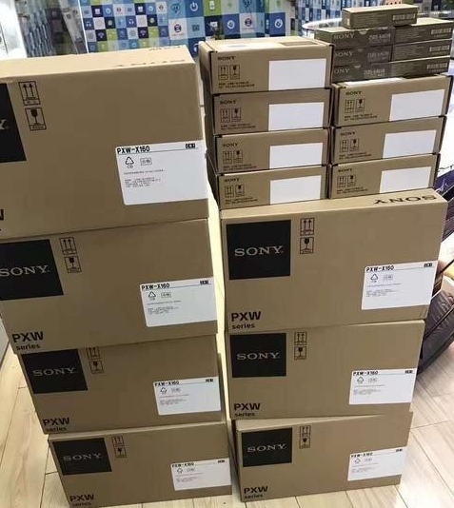
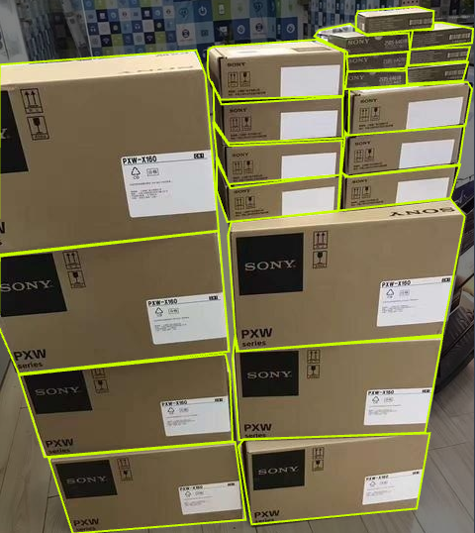
Workflow
Step 2: Label the required objects in the images with required classes (using annotation/segmentation tools)
We have used Roboflow to annotate the packets in the images.
Utilized the already existing JSON file with the annotations/labels and converted to .txt file.
Stock Image
Labelled Image
Source: https://arxiv.org/pdf/2102.12808
3. Workflow

Slide 25
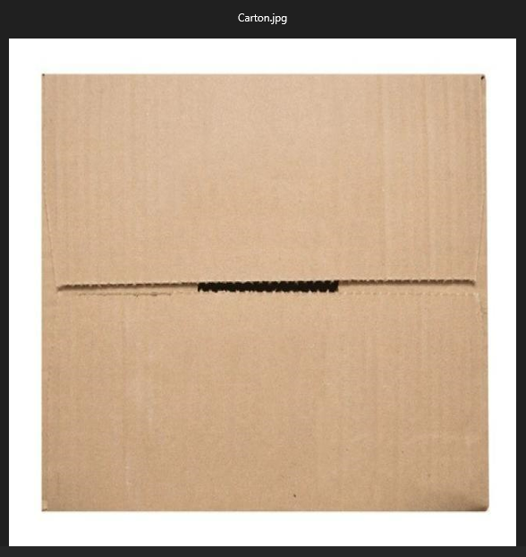
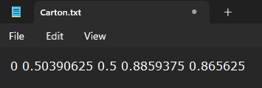
Workflow
Step 3: Download the required labelled files
After labelling the images according to their classes, download all the images and label files required for training.
The five points represent: <class> <x_center> <y_center> <width> <height>
<class>: The class label of the object.
<x_center>: The normalized x-coordinate of the bounding box center.
<y_center>: The normalized y-coordinate of the bounding box center.
<width>: The normalized width of the bounding box.
<height>: The normalized height of the bounding box.
3. Workflow

Slide 26
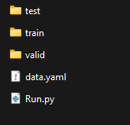
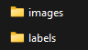
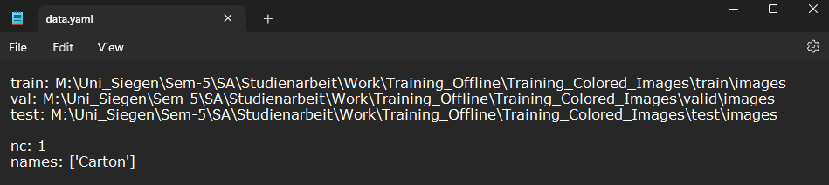
Workflow
Step 4: Files Preparation
Prepare the files in the required YOLO Format.
3 Folders with both images and labels for Training, Validation, and Testing(both image and label should have the same name, but different format)
Create a .yaml file with the paths of above files.
And a python script to run the yolo training.
Files Required
.yaml File
3. Workflow

Slide 27
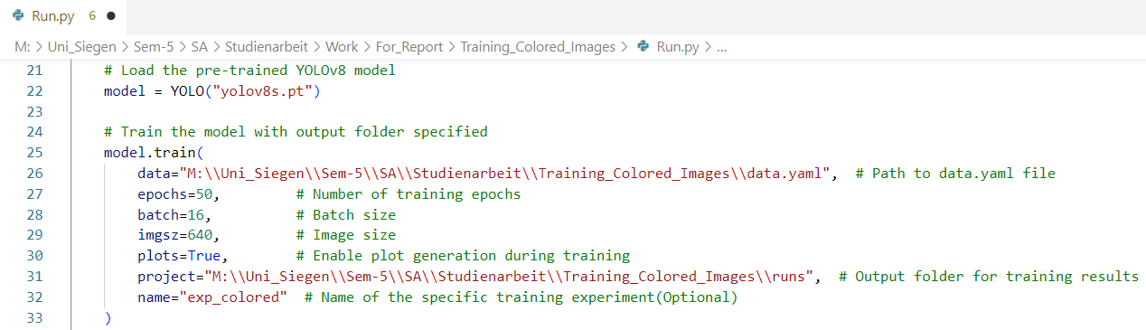
Workflow
Step 5: Training the model with pretrained weights
Python script look like this.
Model Used: YOLO v8s
Epochs: 50
Batch size: 16
Image Size: 640X640
To Save Plots: True
3. Workflow

Slide 28
Dataset Exploration & Training Insights
4

Slide 29
Datasets Explored Till Date
S.No | Dataset Name | Source | Number of Images | Strength | Limitation | Reason to choose
1 | CV_Bucharest | Roboflow | 437 | Single box Detection | Stacked box, Less Accurate | Test
2 | Carton Detection TAD | Roboflow | 626 | Single box Detection, Accuracy | Stacked box | Semantic Segmentation
3 | Online Stacked Carton Dataset (OSCD) | Research Journal | 8401 | Stacked box | Overfitting | Segmentation
4 | Live Stacked Carton Dataset (LSCD) | Research Journal | 7735 | Stacked box | Overfitting | Segmentation
5 | Dataset from MASON | DMK Images Archive | 400 | Single box Detection | Stacked box, Less Accurate | Test
4. Dataset Exploration & Training Insights

Slide 30
Training Experiments Performed
S.No | Dataset | Number of Images | YOLO Model | Epochs | mAP (50-95)* | Performance
1 | CV_Bucharest | 437 | Yolo V8 Small | 25 | 71.69% | Slow Detection, Less Accuracy
2 | Online Stacked Carton Dataset (OSCD) | 8401 | Yolo V8 Small | 5 | 75.27% | Slow Detection, Less Accuracy, Overfitting(Identified any rectangular shape as carton box)
3 | Online Stacked Carton Dataset (OSCD) + CV_Bucharest | 8838 | Yolo V8 Small | 60 | 81.19% | Quick Detection, Very Accurate, Overfitting(Identified any rectangular shape as carton box)
4 | Online Stacked Carton Dataset (OSCD) + CV_Bucharest + Carton Detection TAD | 9464 | Yolo V8 Medium | 180 | 83.95% | Quick Detection, Severe Overfitting(Identified any rectangular shape as carton box)
* mAP is the result observed on validation set which is 20% of the total number of images
Note:
1.All the Training is performed with image size 224x224
2.Performance on real test has not been recorded as no metrics were fixed for Live testing
4. Dataset Exploration & Training Insights

Slide 31
Reference Performance on CPU vs Cluster GPU
Model: YOLO V8 Medium
Processor: Intel(R) Core(TM) i7-10700K CPU @ 3.80GHz
Dataset: ~9400 images
Image size: 224x224 pixels
Time taken for each epoch: 50 Minutes
Image size: 640x640 pixels
Time taken for each epoch: 10 Hours
Model: YOLO V8 Medium
Processor: Nvidia Tesla V 100 16 GB GPU RAM(Cluster)
Dataset: ~9400 images
Image size: 224x224 pixels
Time taken for each epoch: --
Image size: 640x640 pixels
Time taken for each epoch: 50 Minutes
**10 hours on CPU vs 50 Minutes on GPU is drastic improvement in terms of time consumption for the same YOLO model, same dataset, same image size .
4. Dataset Exploration & Training Insights

Slide 32
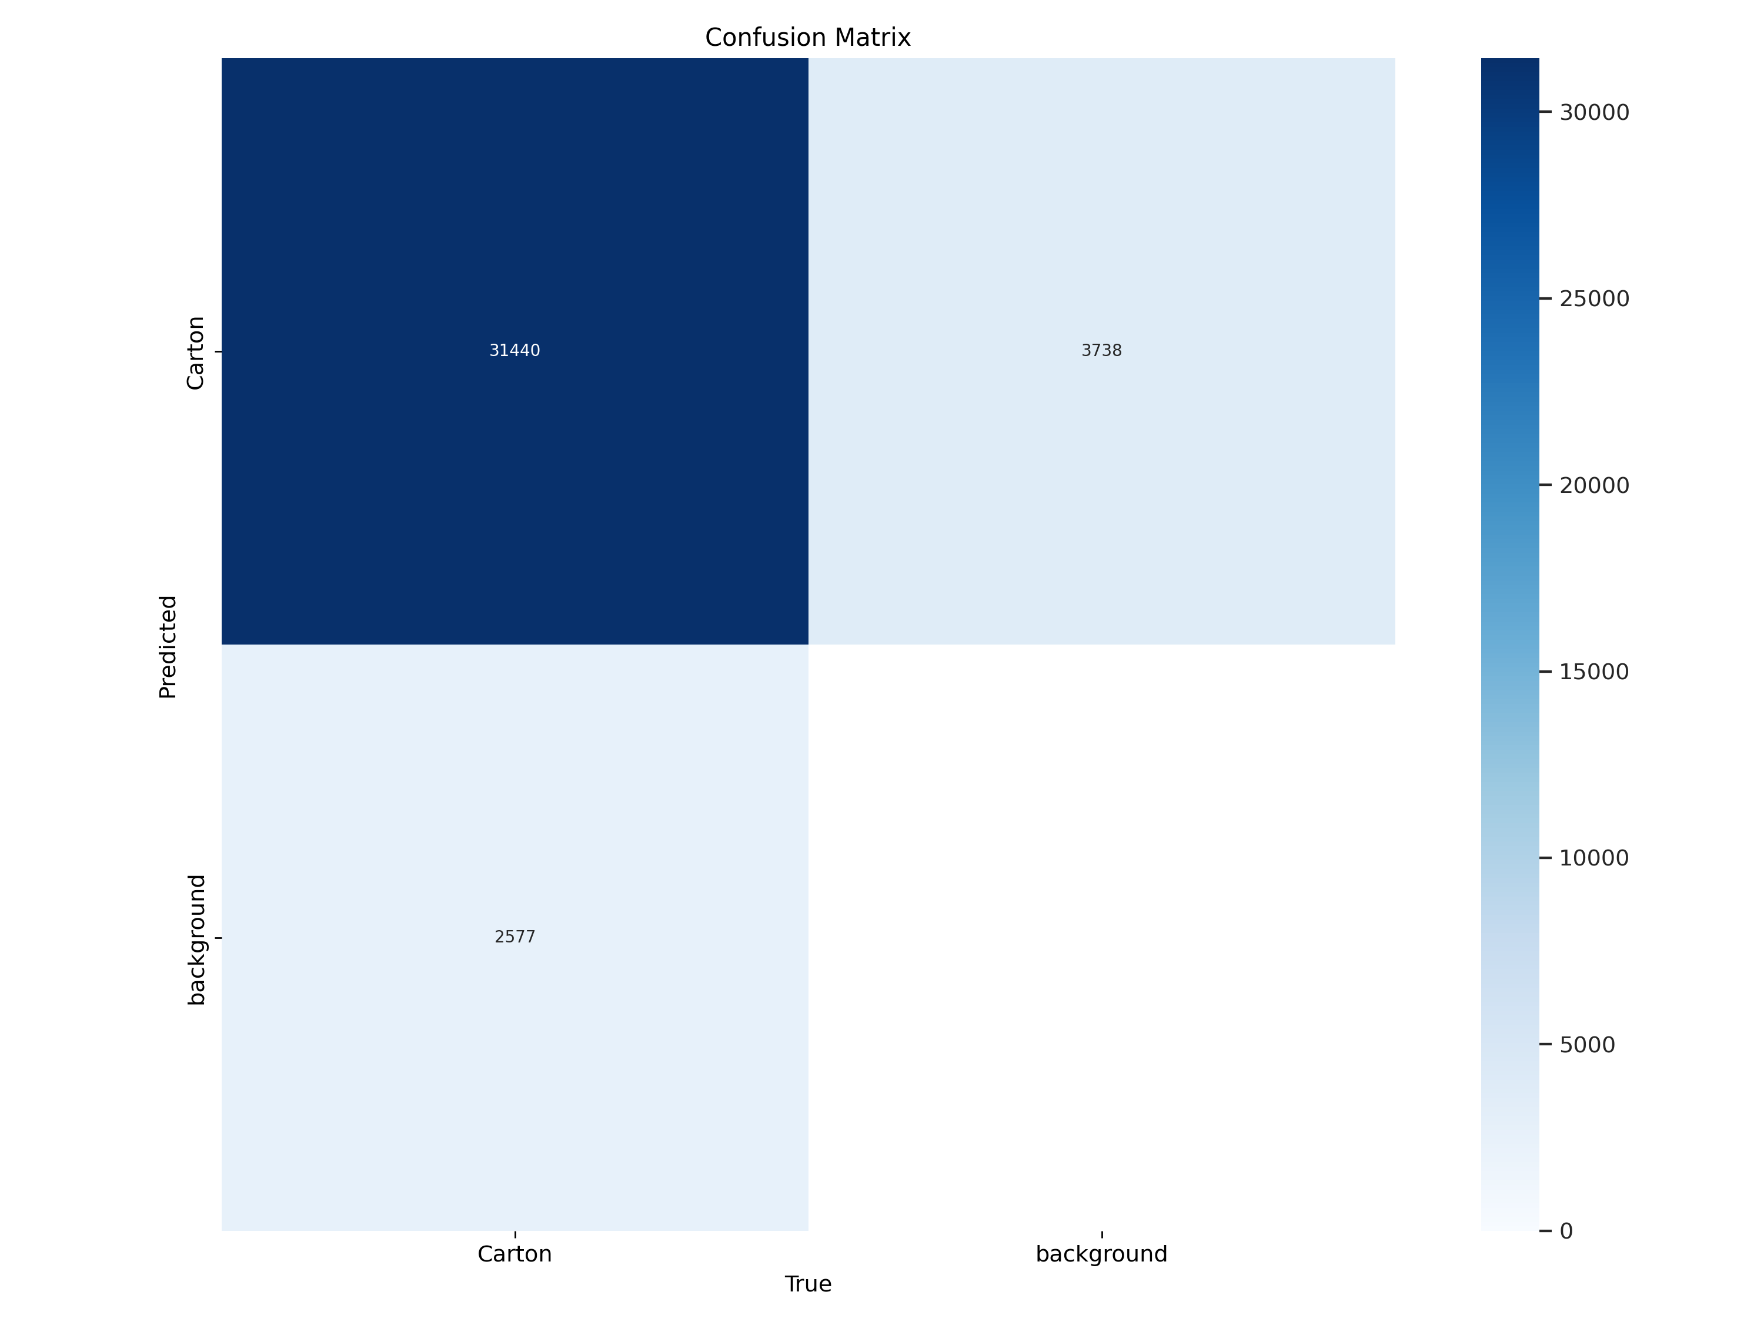
Reference Result of Experiment
In total there were 8630 images with 37755 instances of cartons in the images.
Training Split = 6123 images
Validation Split = 1670 images
Test Split = 837 images
Confusion matrix shows that the there were 6315 instances where background was identified as Carton boxes
4. Dataset Exploration & Training Insights

Slide 33
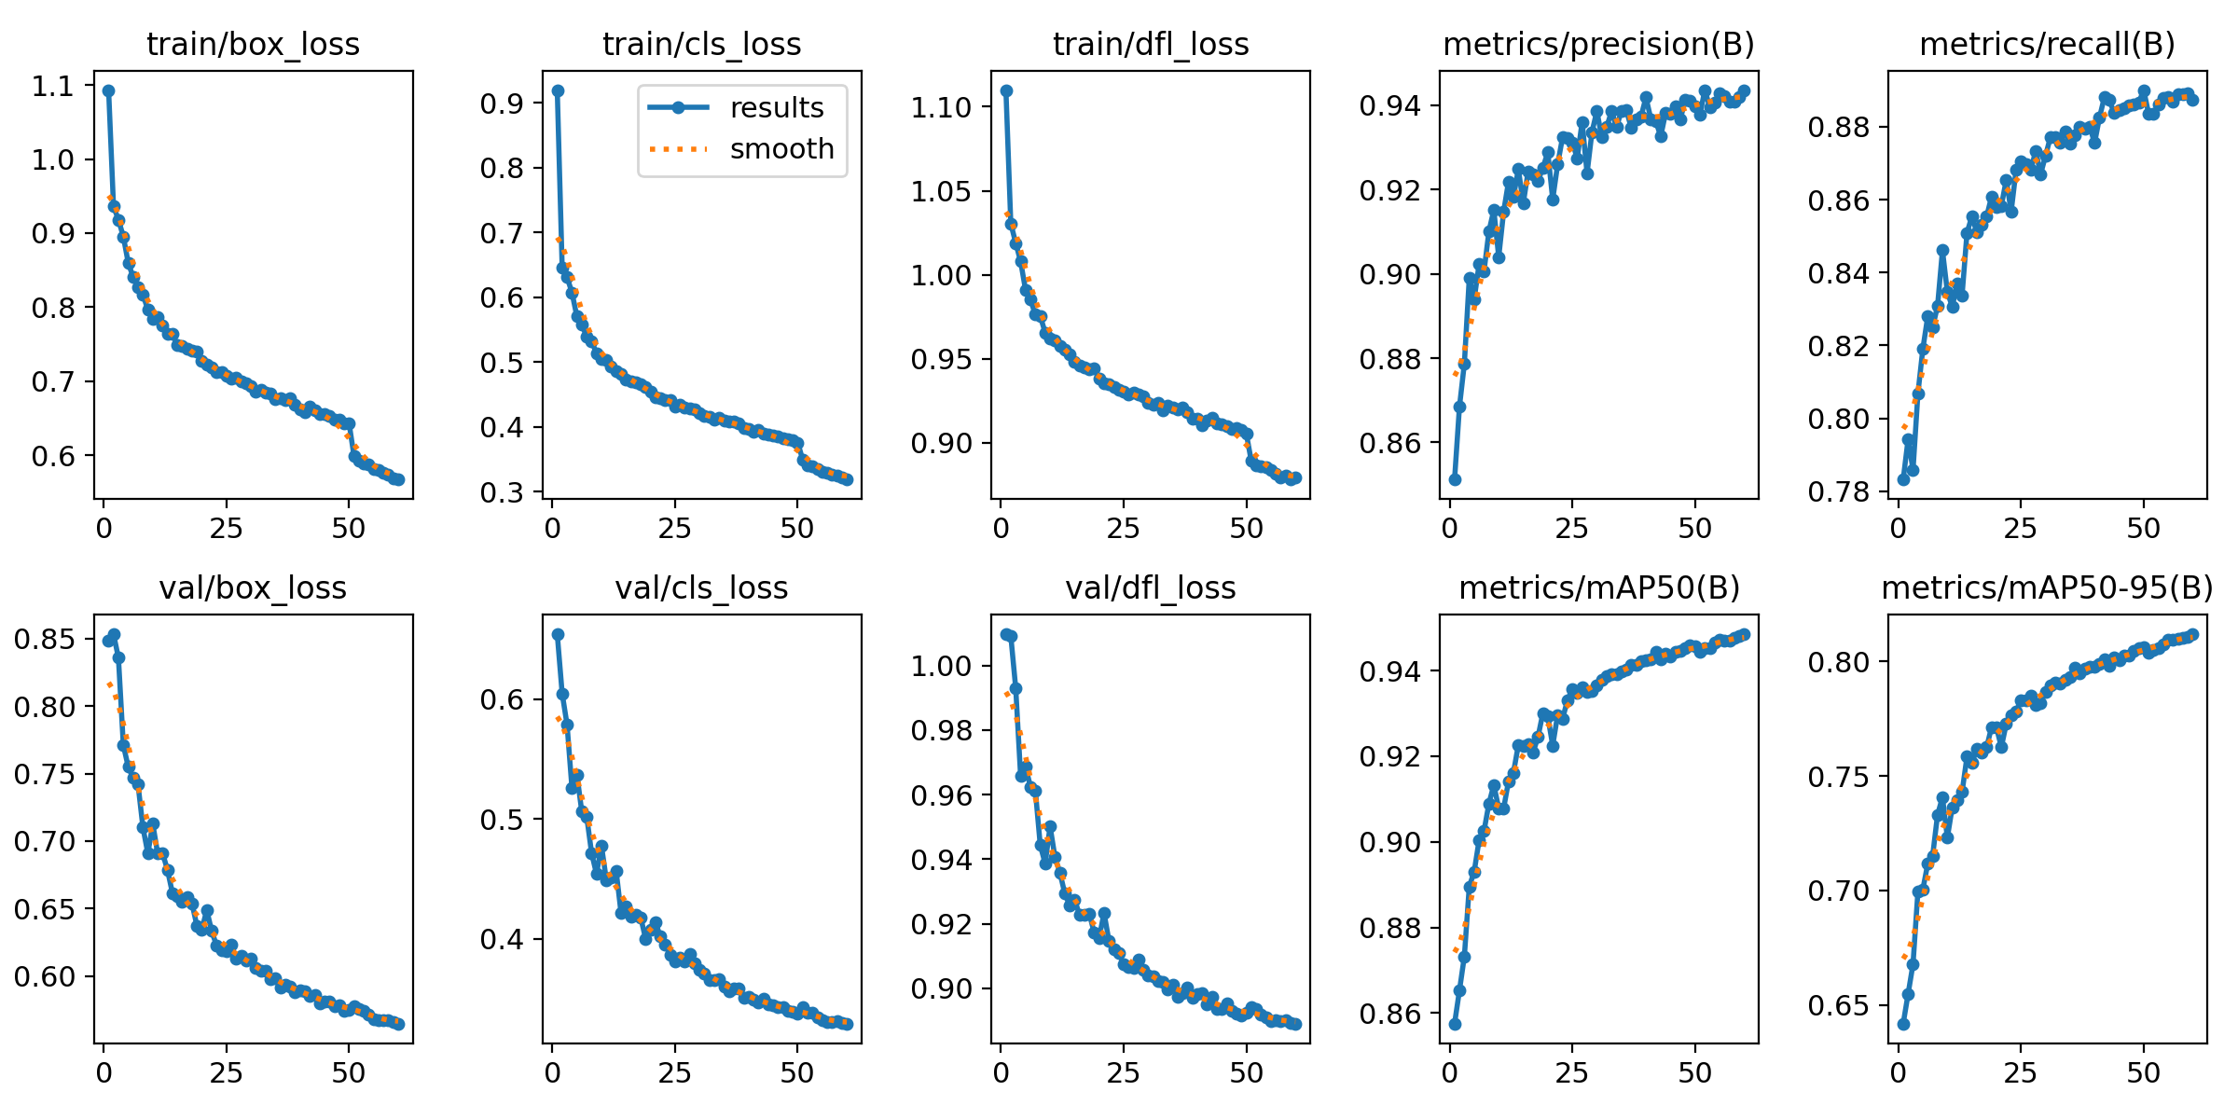
Reference Result of Experiment
Precision - 94.3%
Recall – 88.8%
mAP50 – 94.9%
mAP50-90 – 81.2%
The box loss and the class loss graphs indicate there is still scope for improvement as the loss graphs are still declining and the precision graphs are still rising.
4. Dataset Exploration & Training Insights

Slide 34
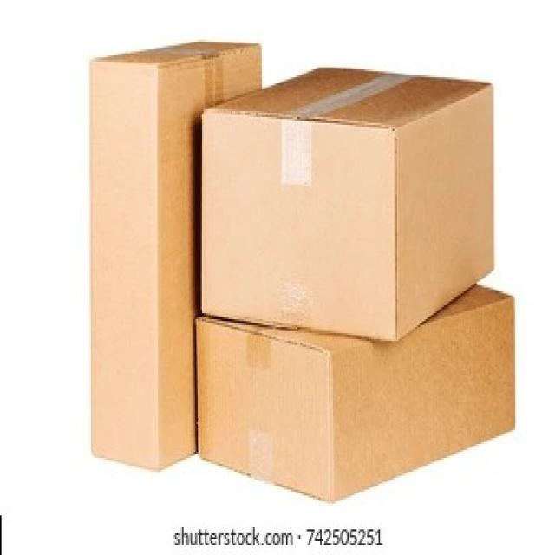

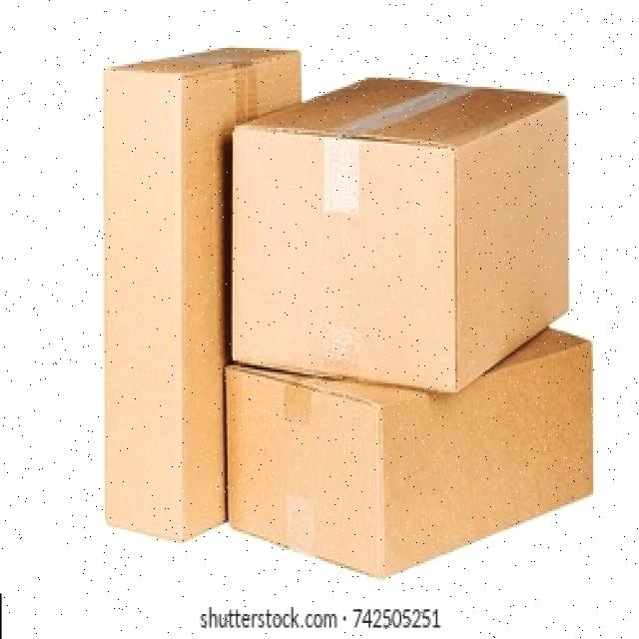
Data Augmentation
Technique used to enhance the diversity of training data without collecting new data.
The first transformation involves adjusting the brightness of the images, increasing and decreasing it by 10%, which helps the model handle variations in lighting conditions during real-world applications.
Random noise is also introduced, where 1% of the pixels are altered, simulating grainy or distorted images often encountered while capturing in low lighting conditions.
The Original Image
Augmented Image:
10% Dark and 1%Noise
Augmented Image:
10% Bright and 1%Noise
4. Dataset Exploration & Training Insights

Slide 35
Observations from Integration Meeting
5

Slide 36
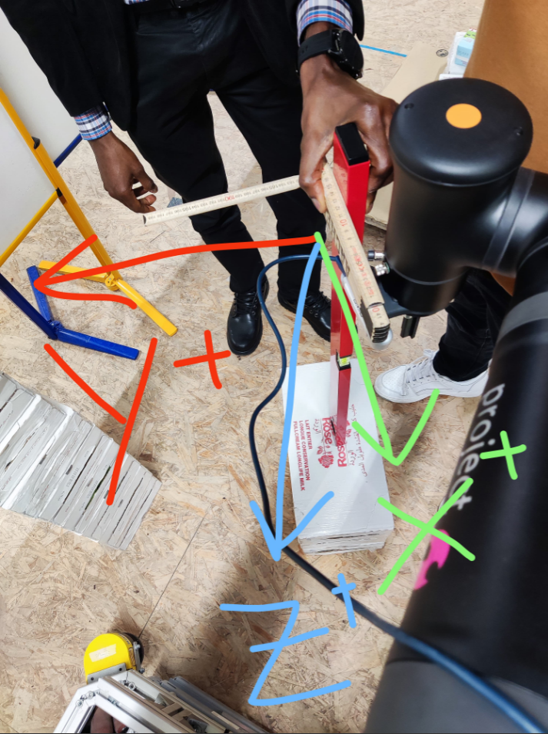
Observations from the Integration meeting
Model was overfitting to only detect boxes when there is a label.
Also Stacked boxes are detected as one whole box rather than individual carton boxes.
Performance is inconsistent due to lighting conditions and different Box sizes.
Camera angle is more crucial for detection than the estimated difference.
Different Coordinate systems are required for different positions
Centroid calculation is done based on the position of the carton box in the image and not the actual centroid of the Carton box.**
Fig: Reference Frame or the main Coordinate system at the centre of the depth sensor
5. Observations from Integration Meeting

Slide 37
Challenges & Key Insights
6

Slide 38
Challenges in Detection and Classification
Training Challenges & Solution
Lighting conditions - Data Augmentation
Noise from the sensor - Calibration
Overfitting - Balanced Dataset
Processing Power - Reduced Dataset
Cluster Challenges
Dependencies version compatibility is a major issue for using Ultralytics as we faced issues with CUDA and torch version compatibility on which we are working on.
So cannot be used while still resolving the issue and when results are required quickly as we had to work on CPU on specific occasions.
Computational Challenges
Training on CPU alone is time consuming as the datasets are huge.
For reference, each epoch took 10Hours for ~9400 images with YOLO V8 Medium.
6. Challenges & Key Insights

Slide 39
Thank you!

